Slide 1



Week 4
EXPLORATORY DATA ANALYSIS
https://intip.in/EDAIUP2022
Teaching Assistant :
Bramandika (06211940000059)
Maura Putri Defa (06211940000139)
Sepuluh Nopember Institute of Technology, Surabaya - Indonesia

Slide 2
Overview
To build a ggplot, we will use the following basic template that can be used for different types of plots:
ggplot(data = <DATA>, mapping = aes(<MAPPINGS>)) + <GEOM_FUNCTION>()
ggplot(data = surveys_complete)
ggplot(data = surveys_complete, mapping = aes(x = weight, y = hindfoot_length))
Add ‘geoms’, graphical representations of the data in the plot (points, lines, bars):
geom_point() for scatter plots, dot plots, etc.
geom_boxplot() for, well, boxplots!
geom_line() for trend lines, time series, etc.
ggplot(data = surveys_complete, aes(x = weight, y = hindfoot_length)) + geom_point()
‹#›

Slide 3
Overview
Anything you put in the ggplot() function can be seen by any geom layers that you add (i.e., these are universal plot settings). This includes the x- and y-axis you set up in aes().
You can also specify aesthetics for a given geom independently of the aesthetics defined globally in the ggplot() function.
The + sign used to add layers must be placed at the end of each line containing a layer. If, instead, the + sign is added in the line before the other layer, ggplot2 will not add the new layer and will return an error message.
You may notice that we sometimes reference ‘ggplot2’ and sometimes ‘ggplot’. To clarify, ‘ggplot2’ is the name of the most recent version of the package. However, any time we call the function itself, it’s just called ‘ggplot’.

Slide 4
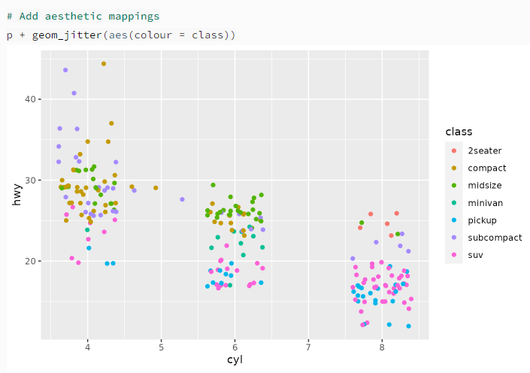
Jitter Plot with ggplot2
The jitter geom is a convenient shortcut for geom_point(position = "jitter"). It adds a small amount of random variation to the location of each point, and is a useful way of handling overplotting caused by discreteness in smaller datasets.
The jitter R function adds noise to a numeric vector. Typically, this numeric vector is censored or rounded to even values (i.e. integer values). The basic syntax for jitter in R is shown above.

Slide 5
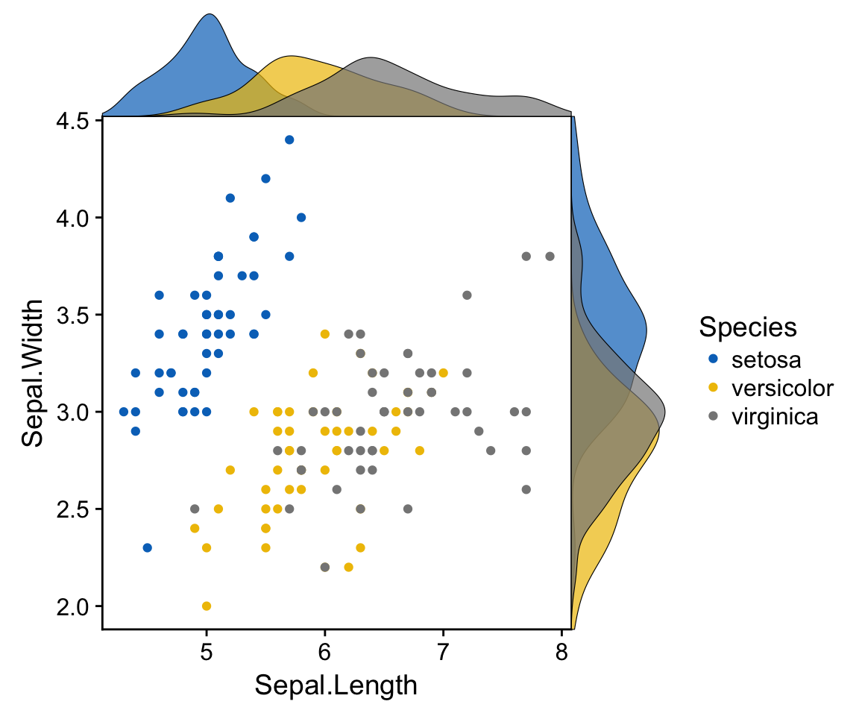
Marginal Plot with ggplot2
A marginal plot is a scatterplot that has histograms, boxplots, or dot plots in the margins of the x- and y-axes. It allows studying the relationship between 2 numeric variables. The base plot visualizes the correlation between the x and y axes variables. It is usually a scatterplot or a density plot.
The marginal charts are commonly plotted on the top and right margin of the base plot and they show the distribution of x and y axes variables using a histogram, barplot, or density plot. This helps us to visualize the distribution intensity at different values of variables along both axes.

Slide 6
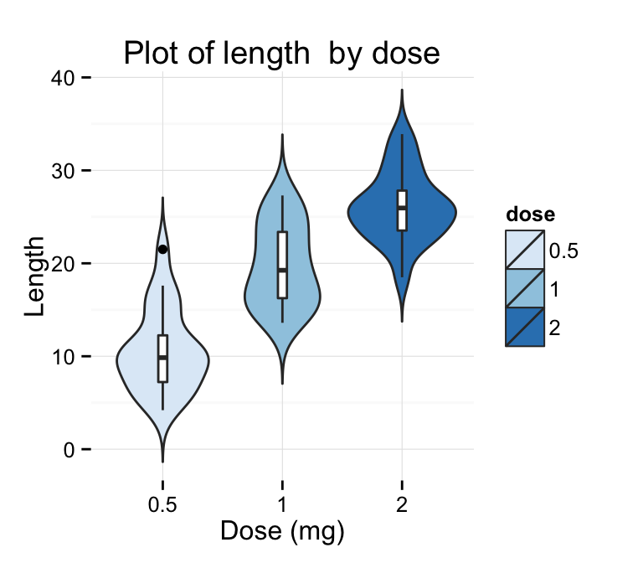
Violin Plot with ggplot2
Violin plots are similar to box plots, except that they also show the kernel probability density of the data at different values. Typically, violin plots will include a marker for the median of the data and a box indicating the interquartile range, as in standard box plots.
The function geom_violin() is used to produce a violin plot.

Slide 7
Violin Plot with ggplot2
Outline
Prepare the data
Basic violin plots
Add summary statistics on a violin plot
Add mean and median points
Add median and quartile
Add mean and standard deviation
Violin plot with dots
Change violin plot colors by groups
Change violin plot line colors
Change violin plot fill colors
Change the legend position
Change the order of items in the legend
Violin plot with multiple groups
Customized violin plots

Slide 8
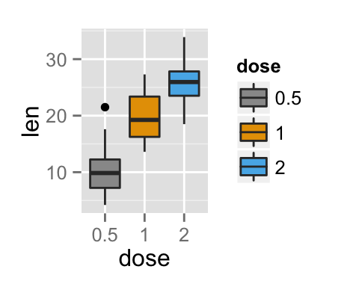
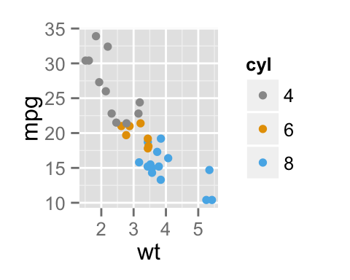
ggplot2 colors
Change colors manually
scale_fill_manual() for box plot, bar plot, violin plot, etc
scale_color_manual() for lines and points
# Box plot bp + scale_fill_manual(values=c("#999999", "#E69F00", "#56B4E9"))
# Scatter plot sp + scale_color_manual(values=c("#999999", "#E69F00", "#56B4E9"))

Slide 9
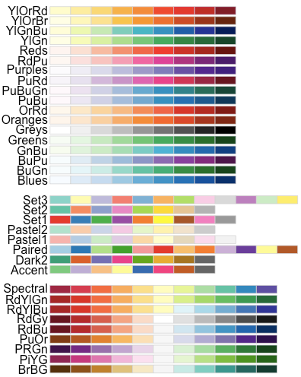
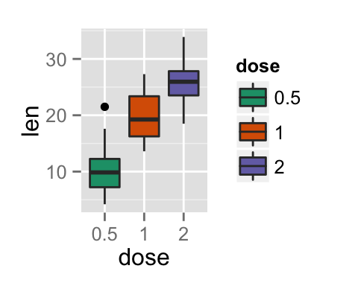
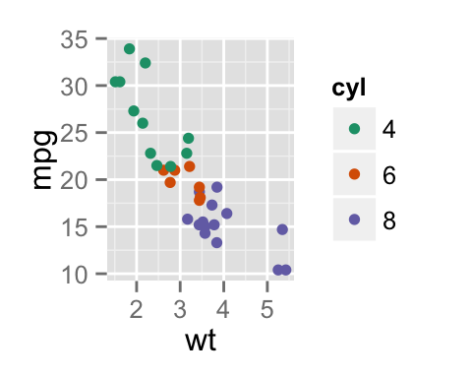
ggplot2 colors
Use RColorBrewer palletes
# Box plot bp + scale_fill_brewer(palette="Dark2") # Scatter plot sp + scale_color_brewer(palette="Dark2")

Slide 10
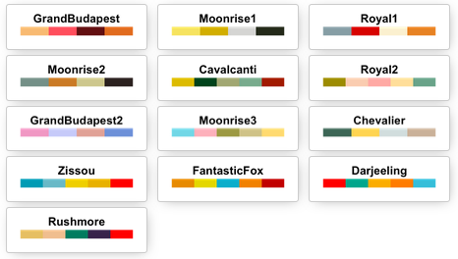
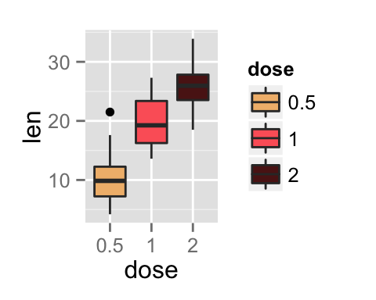
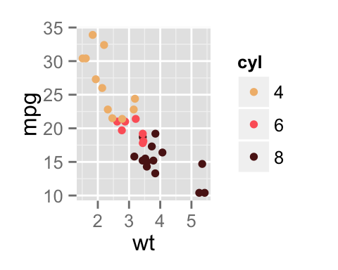
ggplot2 colors
Use Wes Anderson color palettes
# Install install.packages("wesanderson")
# Load library(wesanderson)
The available color palettes are:
library(wesanderson)
# Box plot bp+scale_fill_manual(values=wes_palette(n=3, name="GrandBudapest"))
# Scatter plot sp+scale_color_manual(values=wes_palette(n=3, name="GrandBudapest"))

Slide 11
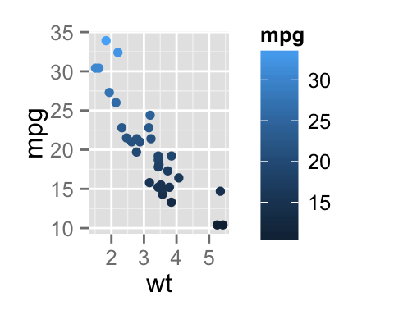
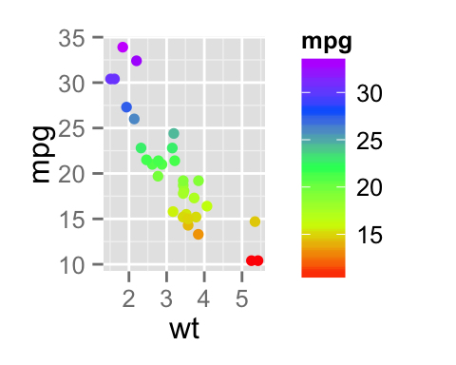
ggplot2 colors
Gradient between n colors
# Scatter plot
# Color points by the mpg variable sp3<-ggplot(mtcars, aes(x=wt, y=mpg, color=mpg)) + geom_point() sp3
# Gradient between n colors sp3+scale_color_gradientn(colours = rainbow(5))

